Slide 1
Digital Signal Processing Project (EE-411)
Triceps Muscle Signal Acquisition and Analysis
Under the supervision of:
Prof. Uttama Lahiri
Ankita Raghuwanshi
Shubham Singh (21110207)
Saurabh Kumar (21110187)
Sudheer Verma (21110216)
Rudransh Surve (21110182)

Slide 2
Outline
1
Problem Statement
6
Conclusion and Summary of Results
2
Data Acquisition
3
Raw Data Analysis
4
Time Domain Analysis
5
Frequency Domain Analysis

Slide 3

Problem Statement
Acquire the muscle signals from the triceps muscle (in the upper arm) during a weight-lifting task (such as a tricep extension) with and without load. Extract the meaningful information from the experimental data and analyse the difference in muscle signals in the two conditions.

Slide 4
Data Collection Overview
Exercises:
Normal Triceps extension:
Performed with and without load.
Overhead Triceps extension:-
Performed with and without load.
Experimental Variations:
Four combinations analysed:
Normal Triceps extension (without load)
Normal Triceps extension(with load)
Overhead Triceps extension (without load)
Overhead Triceps extension(with load)
•Participants:
•Two individuals selected for the study.

Slide 5
Data Acquisition
Steps:
Identify the motor point of the muscle. The motor point is the part of the muscle that undergoes the highest contraction/expansion.
Place one electrode at the bone with little movement, which serves as a reference electrode to measure the potential difference. Secondly, two surface electrodes should be placed close to the motor point and at least 25 mm apart. Signals from these two electrodes were passed through a differential amplifier to minimise the noise in the data.
Use sEMG (Surface electromyography) acquisition device to capture the muscle signal. sEMG is a widely used technology in rehabilitation research.
Sample the data with some sampling frequency to store it digitally. We used a sampling frequency of 1 kHz

Slide 6
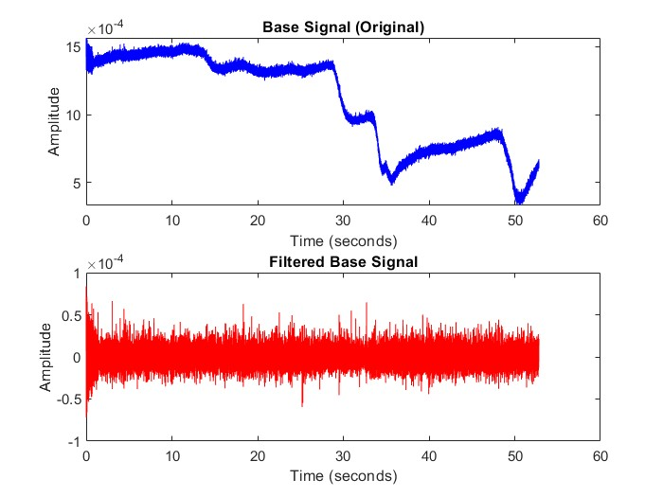
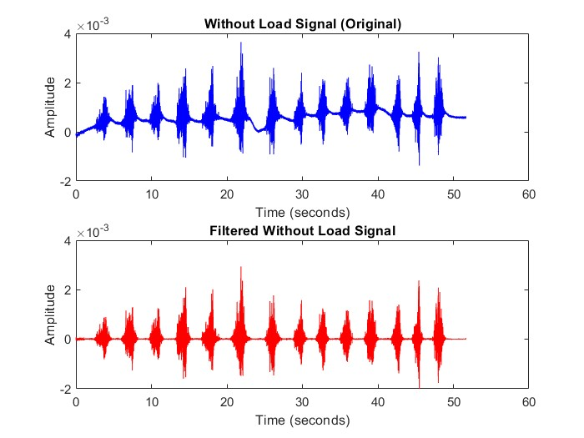
Time Domain Analysis
Player 1 - Exercise 1 (Triceps Kickback)
Filtering Results:

Slide 7
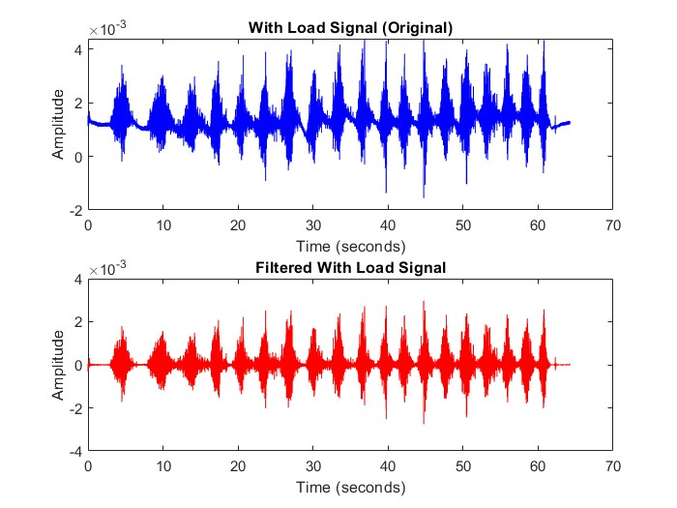
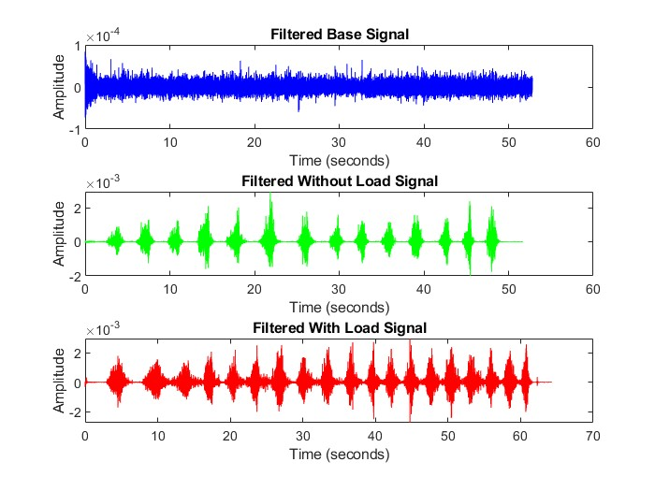
Time Domain Analysis

Slide 8
Time Domain Analysis
For the Filtering we have used two filters: band-pass Butterworth Filter with the band pass 20 to 320 Hz. Second one is a notch filter to remove the 50 Hz grid noise.
For the base Signal we were able to remove enough noise but there is still noise we can see.
For the ‘with load’ and ‘without load’ signal we were able to get nearly the same signal which we desired.
These result shows our filtering is correct.

Slide 9
Time Domain Analysis
For the time domain analysis we have calculated the MAV, RMS and Variance. Filtered Without Load Signal = MAV: 0.407, RMS: 0.409, Variance: 0.002
Filtered With Load Signal= 0.481, RMS: 0.485, Variance: 0.003
When the load is applied, the MAV increases. This indicates that the signal's absolute amplitude has increased, which means when the muscle is exerting more force (due to the load) and contracting more strongly.
A higher RMS value with the load suggests that the muscle is generating more electrical activity or power in response to the external load. This is consistent with the muscle working harder to support the additional weight.
The increase in variance with the load suggests that the muscle’s electrical activity is more variable or less consistent when a load is applied. This could be due to varying muscle contractions, or fatigue.

Slide 10
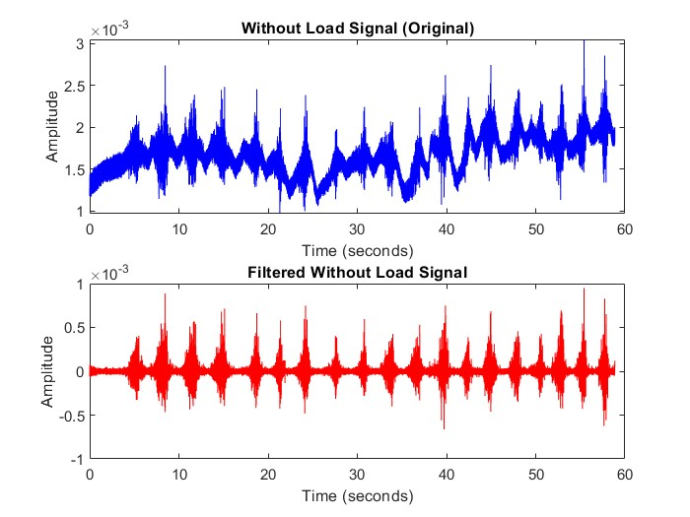
Time Domain Analysis
Player 1 - Exercise 2 (Triceps Overhead Extension)
Filtering Results:

Slide 11
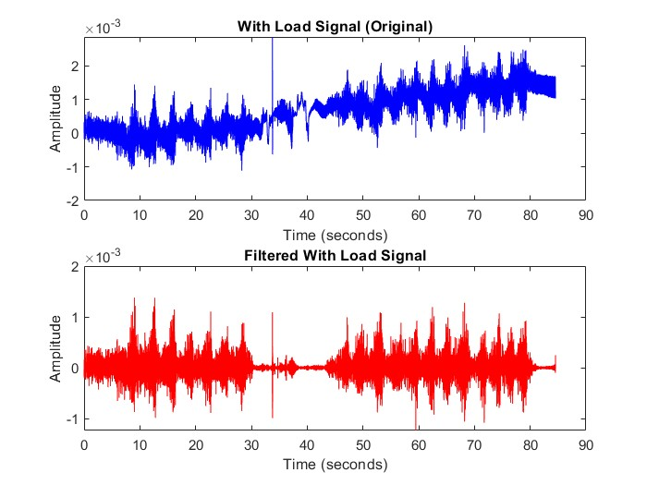
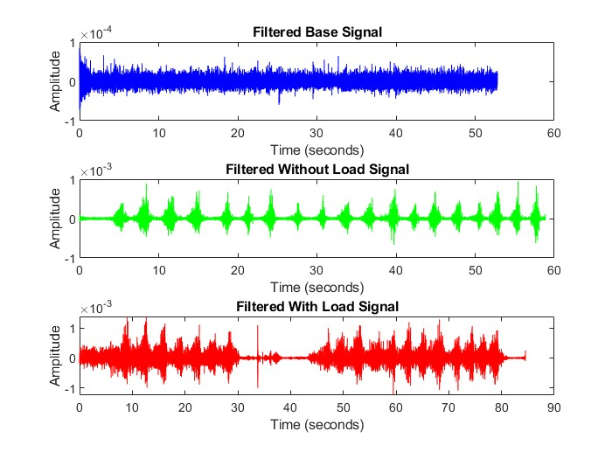
Time Domain Analysis

Slide 12
Time Domain Analysis
Here also we have also used band pass butterworth Filter with the band pass 20 to 320 Hz. Second one is notch filter to remove the 50 Hz.
For the base Signal we were able to remove enough noise but there is still noise we can see.
For the with load and without load signal we were able to get nearly same signal which we wanted.
For the time domain analysis we have calculated the MAV, RMS and Variance. Filtered Without Load Signal = MAV: 0.411, RMS: 0.413, Variance: 0.002
Filtered With Load Signal= MAV: 0.473, RMS: 0.476, Variance: 0.003
When the load is applied, the MAV increases. This indicates that the signal's absolute amplitude has increased, which means when the muscle is exerting more force (due to the load) and contracting more strongly.
A higher RMS value with the load suggests that the muscle is generating more electrical activity or power in response to the external load. This is consistent with the muscle working harder to support the additional weight.
The increase in variance with the load suggests that the muscle’s electrical activity is more variable or less consistent when a load is applied. This could be due to varying muscle contractions, or fatigue.

Slide 13
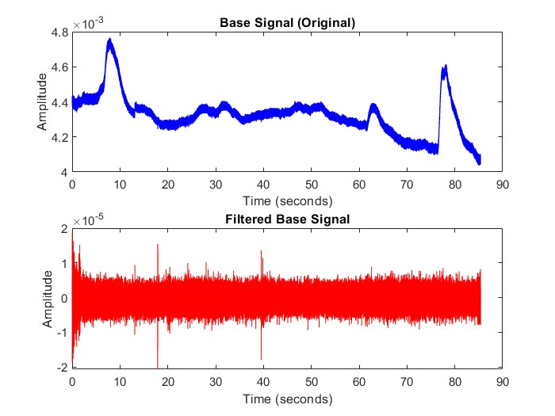
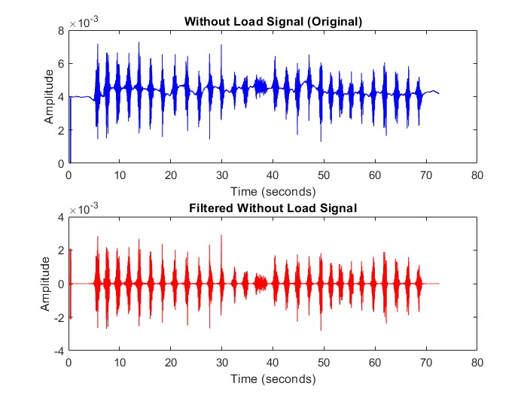
Time Domain Analysis
Player 2 - Exercise 1 (Triceps Kickback)
Filtering Results:

Slide 14
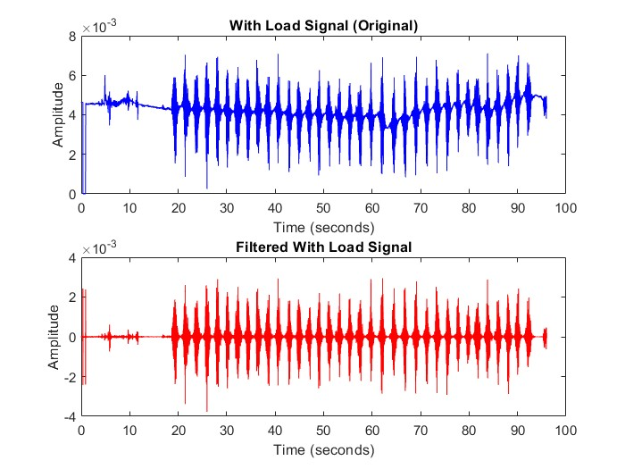
Time Domain Analysis

Slide 15
Time Domain Analysis
Here also we have also used band pass butterworth Filter with the band pass 20 to 320 Hz. Second one is notch filter to remove the 50 Hz.
For the base Signal we were able to remove enough noise but there is still noise we can see.
For the with load and without load signal we were able to get nearly same signal which we wanted.
For the time domain analysis we have calculated the MAV, RMS and Variance. Filtered Without Load Signal = MAV: 0.491, RMS: 0.493, Variance: 0.002
Filtered With Load Signal= MAV: 0.562, RMS: 0.564, Variance: 0.002
When the load is applied, the MAV increases. This indicates that the signal's absolute amplitude has increased, which means when the muscle is exerting more force (due to the load) and contracting more strongly.

Slide 16
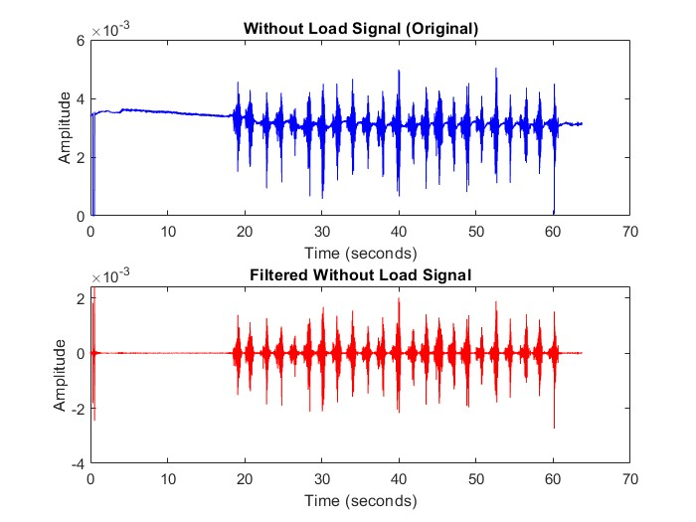
Time Domain Analysis
Player 2 - Exercise 2 (Triceps Overhead Extension)
Filtering Results:

Slide 17
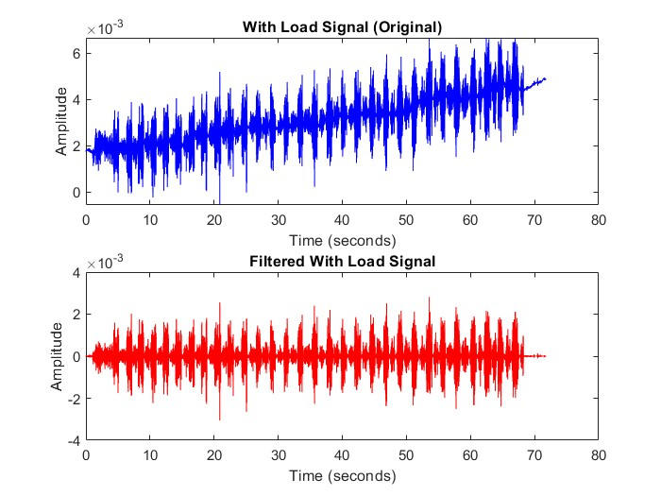
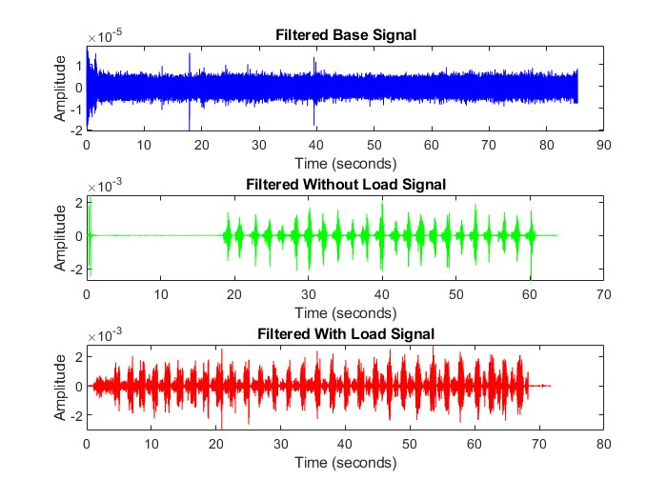
Time Domain Analysis

Slide 18
Time Domain Analysis
Here also we have also used band pass butterworth Filter with the band pass 20 to 320 Hz. Second one is notch filter to remove the 50 Hz.
For the base Signal we were able to remove enough noise but there is still noise we can see.
For the with load and without load signal we were able to get nearly same signal which we wanted.
For the time domain analysis we have calculated the MAV, RMS and Variance. Filtered Without Load Signal = MAV: 0.520, RMS: 0.524, Variance: 0.001
Filtered With Load Signal= MAV: 0.531, RMS: 0.532, Variance: 0.001
When the load is applied, the MAV increases. This indicates that the signal's absolute amplitude has increased, which means when the muscle is exerting more force (due to the load) and contracting more strongly.
A higher RMS value with the load suggests that the muscle is generating more electrical activity or power in response to the external load. This is consistent with the muscle working harder to support the additional weight.

Slide 19
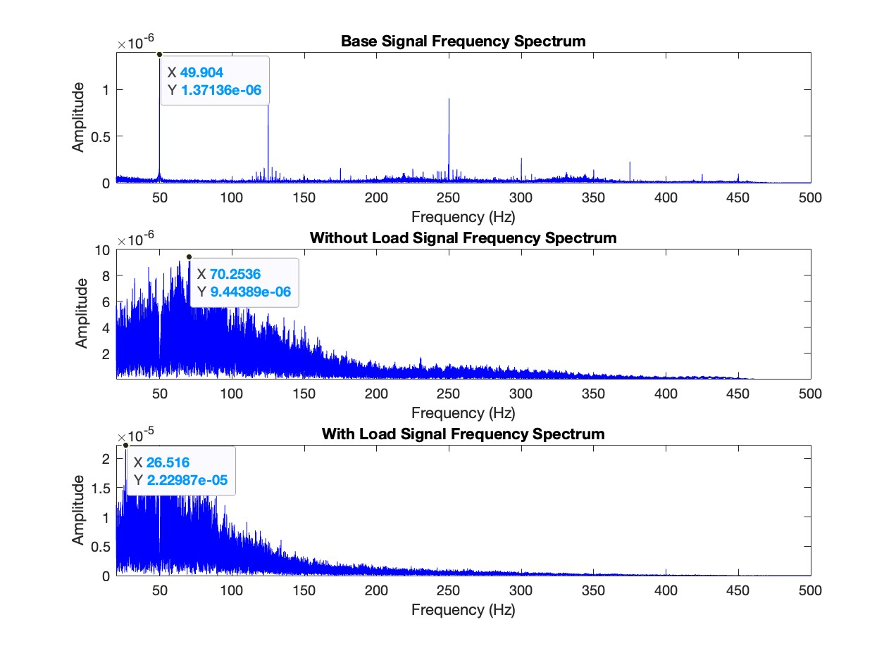
Frequency Domain Analysis
Player 1- Exercise 1 (Triceps Kickback)
Base Signal:
The signal exhibits three dominant frequestion.
Without Load Signal:
Increased frequency components in the range of 20–250 Hz compared to the base signal, indicating muscle activation during exercise without load.
With Load Signal:
Significant increase in amplitude within the 20-150 Hz range, reflecting heightened muscle activity under load.

Slide 20
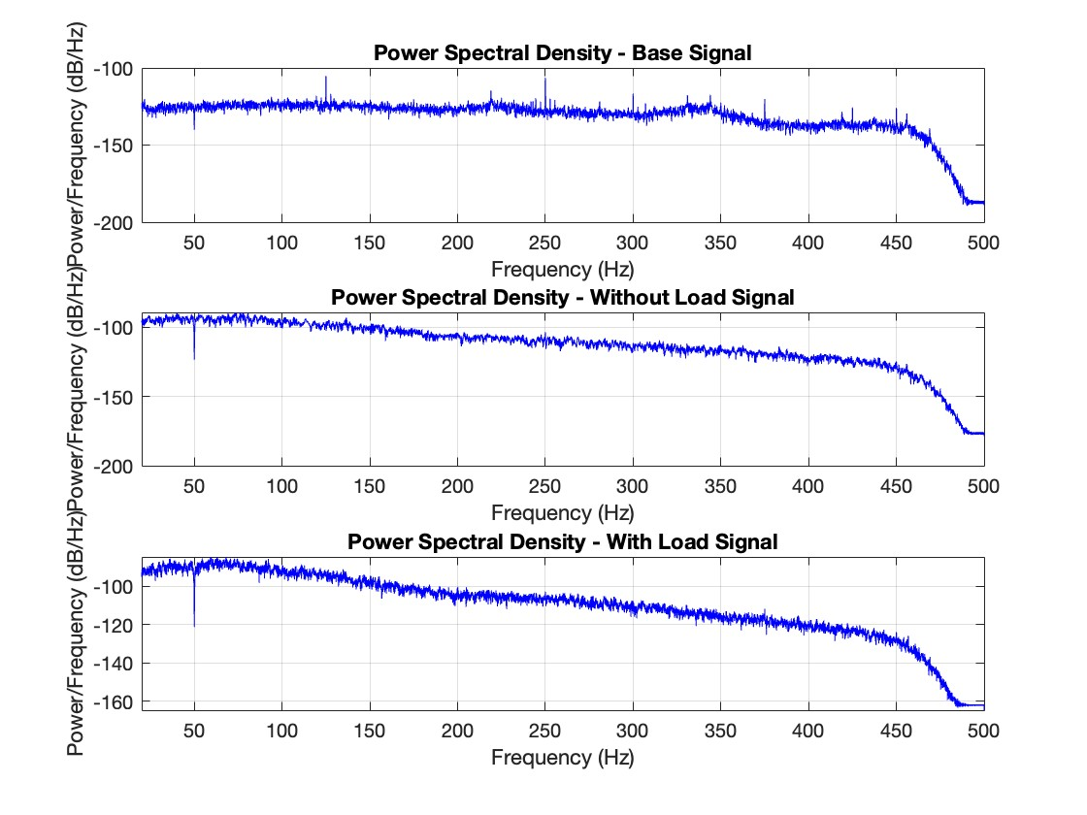
Power Spectral Density
Base Signal: Low power , consistent with minimal muscle engagement.
Without Load Signal: Increased power density in the 20–250 Hz range, indicating active muscle contraction.
With Load Signal: Highest power density across 20–100 Hz, reflecting substantial effort and motor unit recruitment under load.

Slide 21
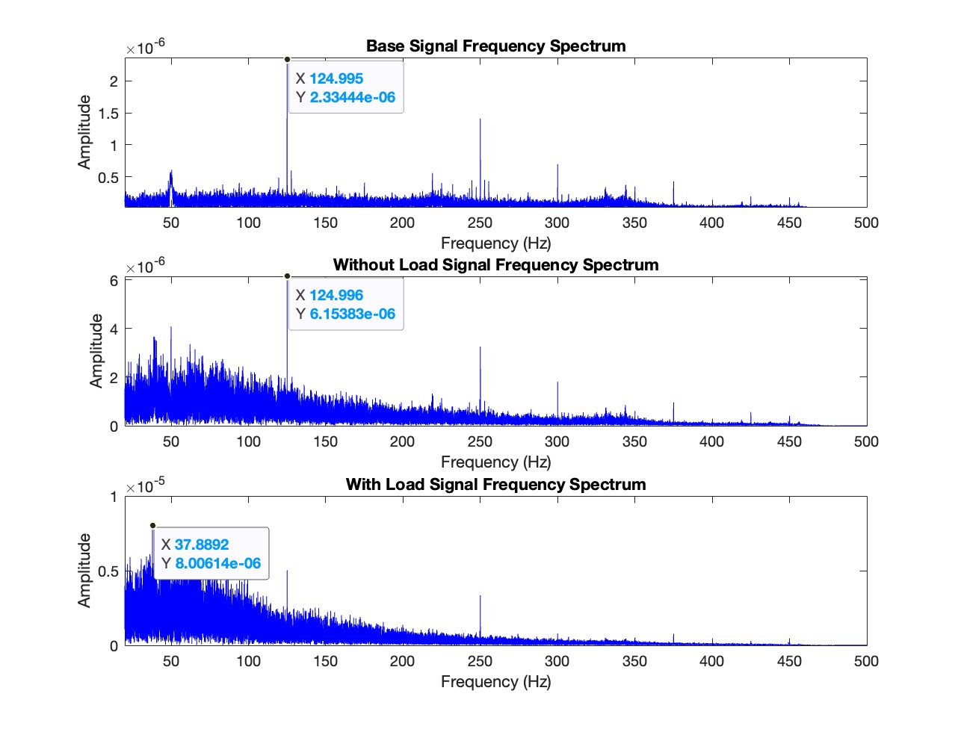
Frequency Domain Analysis
Base Signal:
The signal exhibits three dominant frequestion.
Without Load Signal:
Increased frequency components in the range of 20–250 Hz compared to the base signal, indicating muscle activation during exercise without load.
With Load Signal:
There is increase in amplitude within the 20-150 Hz range, reflecting heightened muscle activity under load.
Player 1 - Exercise 2 (Triceps Overhead Extension)
In the second exercise we have seen little chance in amplitude between with load and without load because in triceps extension our muscle are already engaged we were already fatigue a

Slide 22
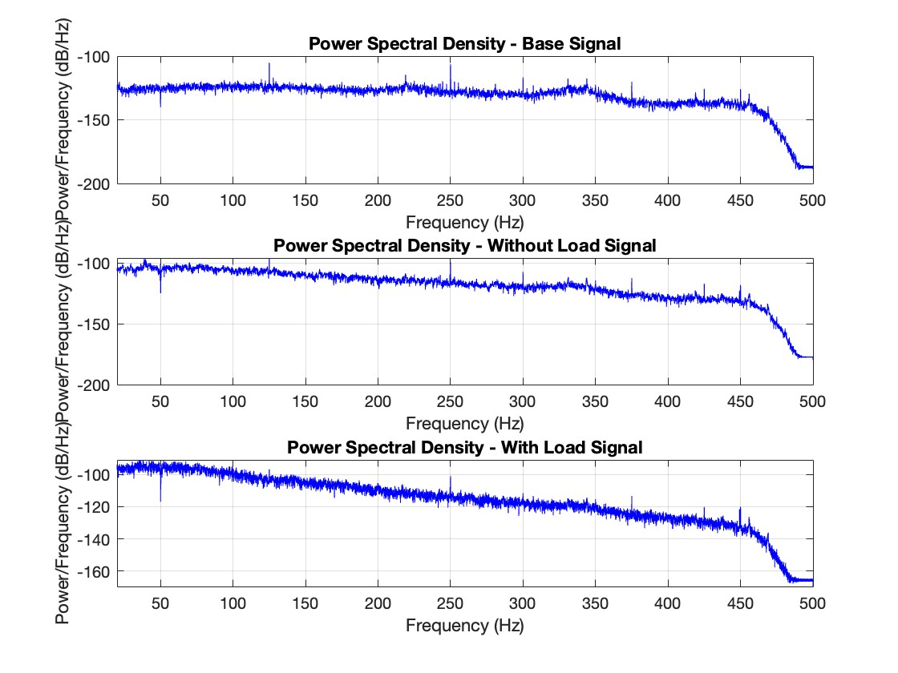
Power Spectral Density
Base Signal: Low power , consistent with minimal muscle engagement.
Without Load Signal: Increased power density in the 20–250 Hz range, indicating active muscle contraction.
With Load Signal: Highest power density across 20–100 Hz, reflecting substantial effort and motor unit recruitment under load.

Slide 23
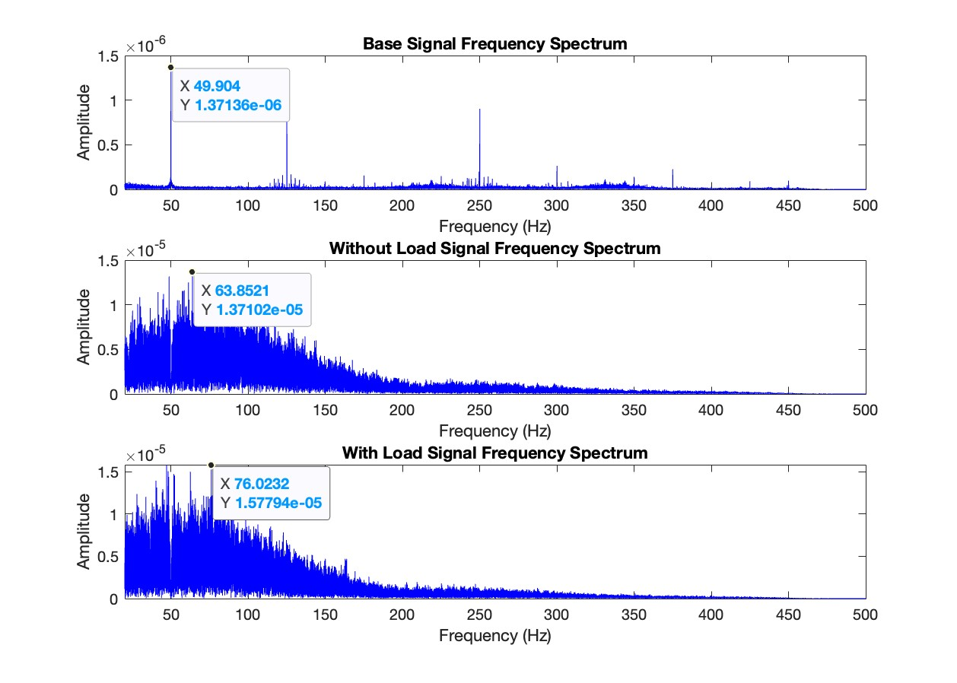
Frequency Domain Analysis
Base Signal:
The signal exhibits three dominant frequestion.
Without Load Signal:
Increased frequency components in the range of 20–250 Hz compared to the base signal, indicating muscle activation during exercise without load.
With Load Signal:
Significant increase in amplitude within the 20-150 Hz range, reflecting heightened muscle activity under load.
Player 2 - Exercise 1 (Triceps Kickback)

Slide 24
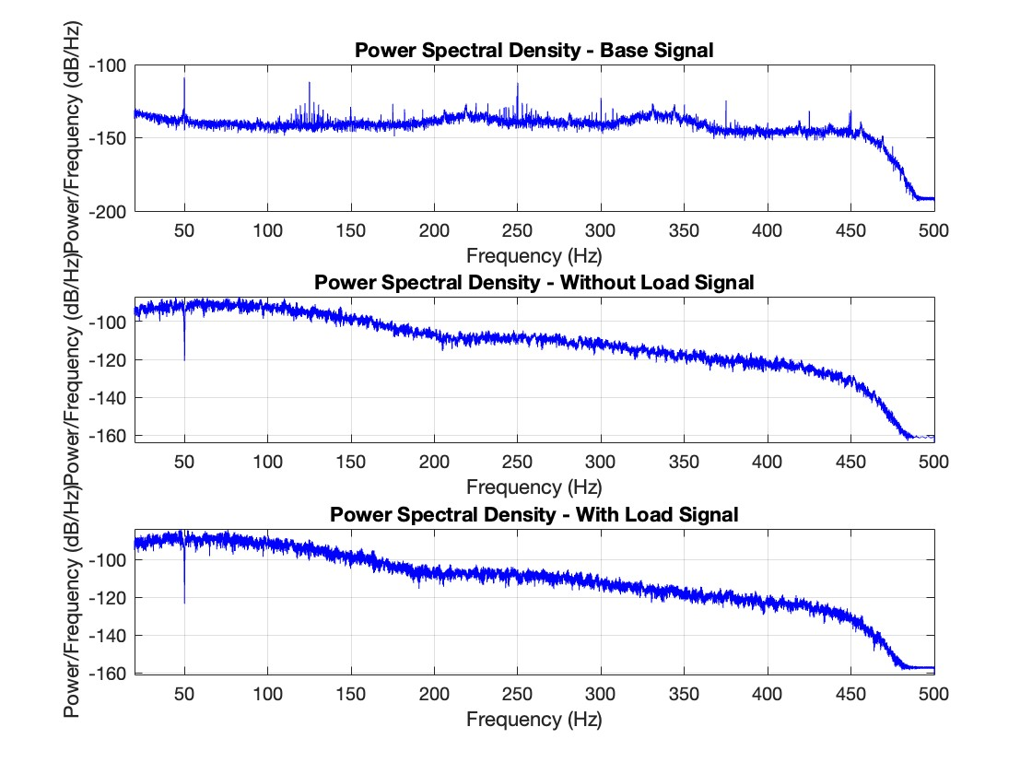
Power Spectral Density
Base Signal: Low power , consistent with minimal muscle engagement.
Without Load Signal: Increased power density in the 20–250 Hz range, indicating active muscle contraction.
With Load Signal: Highest power density across 20–100 Hz, reflecting substantial effort and motor unit recruitment under load.

Slide 25
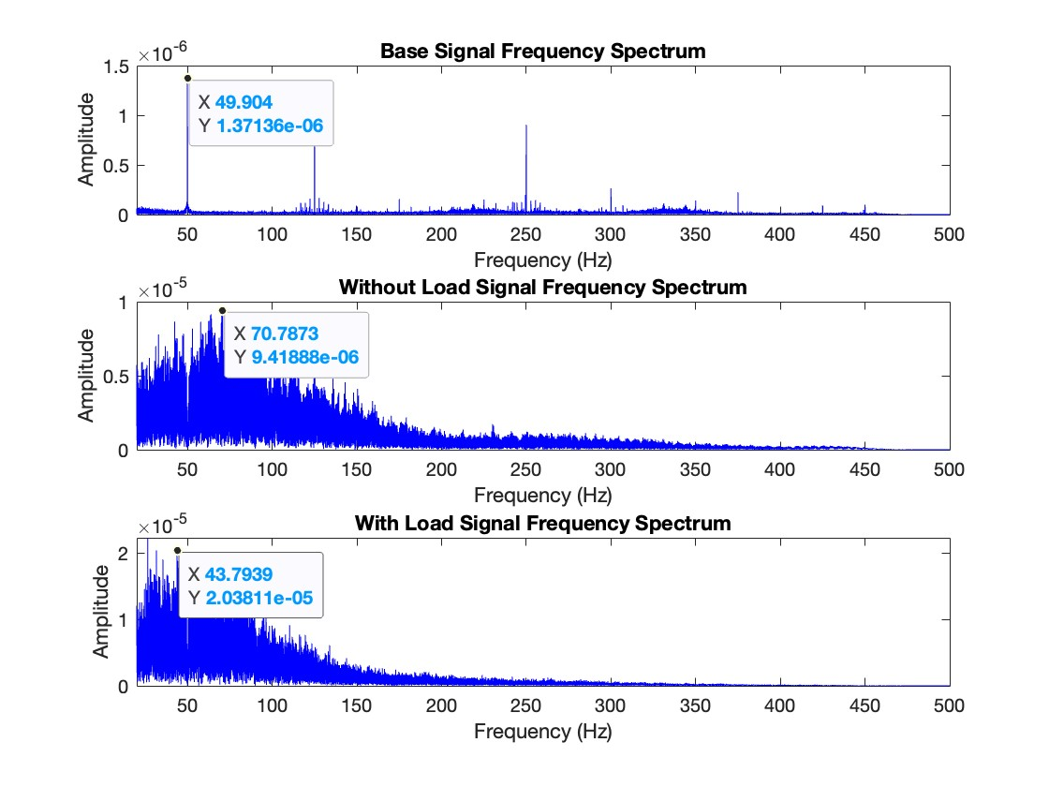
Player 2- Exercise 2 (Triceps Overhead Extension)
Base Signal:
The signal exhibits three dominant frequestion.
Without Load Signal:
Increased frequency components in the range of 20–250 Hz compared to the base signal, indicating muscle activation during exercise without load.
With Load Signal:
Significant increase in amplitude within the 20-150 Hz range, reflecting heightened muscle activity under load.

Slide 26
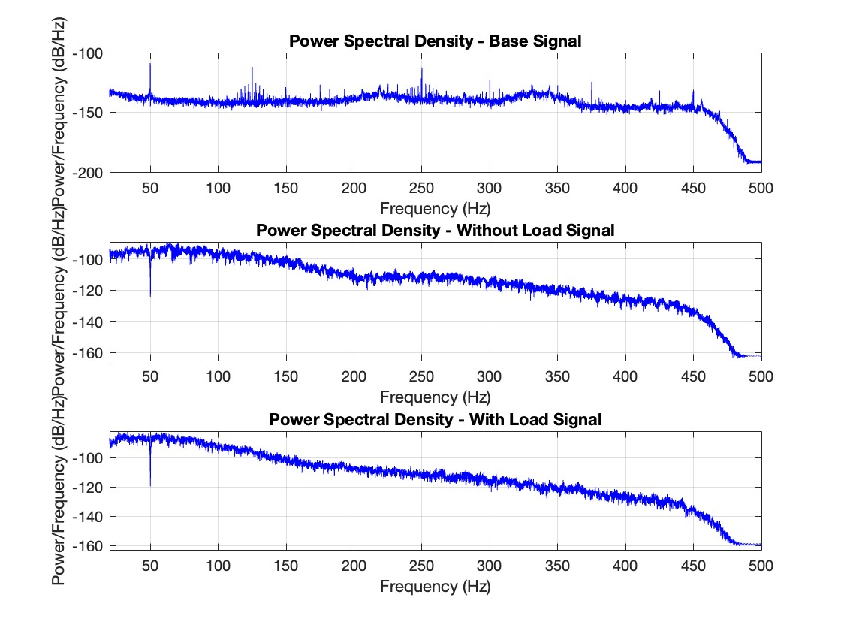
Base Signal: Low power , consistent with minimal muscle engagement.
Without Load Signal: Increased power density in the 20–250 Hz range, indicating active muscle contraction.
With Load Signal: Highest power density across 20–100 Hz, reflecting substantial effort and motor unit recruitment under load.

Slide 27
Conclusion:
Significant differences in triceps muscle signals were observed. The baseline (rest) signal showed minimal muscle activity, confirming no engagement at rest.
Exercise 1 and 2 (no load) showed clear triceps activation with increased frequency components, indicating muscle engagement during movement.
With load, the signal amplitude increased, indicating greater muscle activation and recruitment of additional muscle fibers to overcome resistance.
PSD analysis showed a shift in frequency distribution under load, with muscle fatigue developing earlier under load compared to no load, indicating higher stress and faster fatigue onset with increased resistance.
For both players, MAV and RMS increase with load as the muscle generates more force to lift the additional weight.
Player 1 shows a larger increase in activation with more variability (higher variance), indicating less efficient muscle activation. This suggests less optimal use of muscle fibers, possibly due to poor coordination or fatigue, requiring more effort to complete the task.
Could posture affect this? Yes, improper posture may lead to inefficient muscle activation and increased variability.
Player 2 shows a more controlled activation with consistent variance, indicating more efficient muscle use. This suggests better coordination and training, requiring less effort for the same task.

Slide 28
Contribution:
Every group member has contributed equally in this project. We have conducted 4 group meetings in which every individual has contributed.
Saurabh Kumar | Data Acquisition, Time domain analysis, Frequency domain analysis, final presentation
Shubham Singh | Data Acquisition, Time domain analysis, Frequency domain analysis, final presentation
Sudheer Verma | Data Acquisition, Time domain analysis, Frequency domain analysis, final presentation
Rudransh Surve | Data Acquisition, Time domain analysis, Frequency domain analysis, final presentation

Slide 29
Thank You

